Slide 1
Linked Lists, Storing Stacks and Queues using Linked Lists: Lecture 08 Fall 2016

Slide 2
Agenda
Discuss Roscoe flowchart and Float worksheet.
https://www.h-schmidt.net/FloatConverter/IEEE754.html
Test: Friday 10/21. I will hand out review guide by 10/17.
No classes on 10/14.
Most likely there will be only 2 tests and a final.
Today’s lecture, and Lab this week:
Storing Stacks using Linked lists
Storing Queues using Linked Lists
zyBook assignment as part of lab
Next time:
Storing Queues using arrays – more complicated!

Slide 3
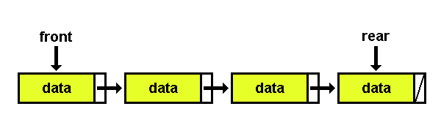
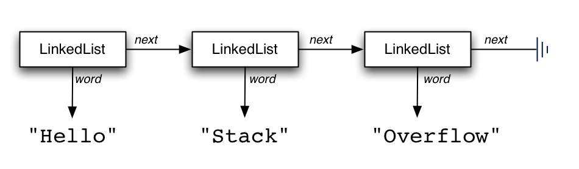
Represent Stack using Linked List
Sometimes we use a “count” or “length” variable as well.
The data will also be a reference if it is an Object – not a problem.
Strings are Objects !

Slide 4
Complexity “Order of”
O(1) – constant time “Order of 1”
Takes same amount of steps regardless of items in the collection.
O(N) – “Order of N”
Takes steps proportional to N, the number of items in the collection, or “the size of the problem.” Assume N could be very large.
We will cover other “O” later

Slide 5
Linked Lists can store Stacks
List interface:
boolean add (T newEntry)
boolean add (int newPosition, T newEntry)
T remove (int givenPosition)
void clear( ) and getLength( )
boolean replace(int givenPosition, T newEntry)
Stack interface:
T pop( )
T peek( )
void push(T newEntry)

Slide 6
List ADT simulates a Stack
T pop( ) { return remove(1); }
T peek( ) { return getEntry(1); }
void push( T newEntry) { add(1, newEntry); }
boolean add (int newPosition, T newEntry)
boolean isEmpty( )
Are these O(1) or O(N) ?

Slide 7
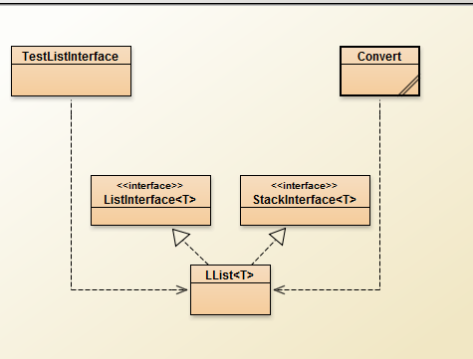
Linked List lab with added Stack behavior

Slide 8
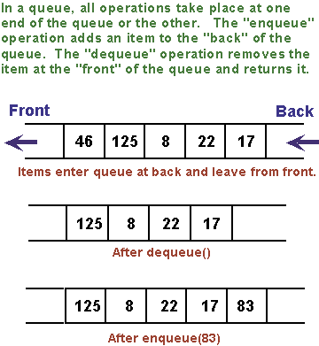
Queues

Slide 9
Queues

Slide 10
Linked Lists can store Queues

Slide 11
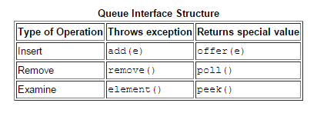
Java Queue Interface inherits from the general Collection class
We will use enqueue and dequeue in this course, however.

Slide 12
Queues vs. Stacks

Slide 13
Queues: Linked List Implementation #1
Front
How efficient is this implementation for a queue?
Enqueue? O(1) or O(N) ?
getFront? O(1) or O(N) ?
isEmpty? O(1) or O(N) ?
Dequeue ? O(1) or O(N) ?

Slide 14
Queues: Linked List Implementation #1
Front
Simulate Queue with a Linked List
How efficient is this implementation for a queue?
O(1) or O(N) ?
void enqueue(T newEntry) { add(getLength( )+1, newEntry); }
T getFront( ) { return getEntry(1); }
isEmpty() {return length == 0; }
T dequeue( ) { return remove(1); }

Slide 15
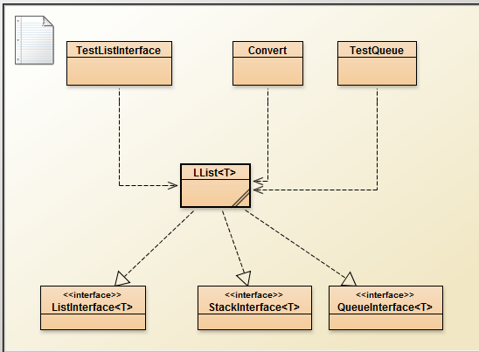
LList with additional Stack and Queue behaviors

Slide 16
Queues: Linked List Implementation #2
Front
Back
How efficient is this implementation for a queue? Any better?
getFront: O(1) or O(N) ?
isEmpty: O(1) or O(N) ?
Dequeue: O(1) or O(N) ?
Enqueue: O(1) or O(N) ?
Consider the efficiency of your ADT implementations!

